Slide 1

Florida
K-Readiness
School Assessment Coordinator Training
Fall 2021

Slide 2

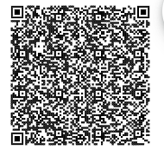
Training Topics
The FLKRS Assessment: Star Early Literacy
Getting Ready to Administer the Assessment
Assessing Students
Overview of K-Readiness Reports
Support and Resources
Q & A
Sign-in

Slide 3
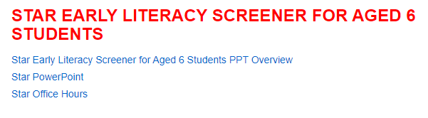
Briefing #30740
https://arda.dadeschools.net/#!/fullWidth/3971

Slide 4

The FLKRS Assessment

Slide 5
Star Early Literacy is the Florida Kindergarten Readiness Screener (FLKRS)
Section 1002.69, Florida Statutes, requires FDOE to adopt a statewide kindergarten screening instrument that assesses the readiness of each K-enrolled student for kindergarten.
The screener shall be
  administered within the first 30 school days of the school year
  (August 23 – October 6, 2021)
  based on performance standards adopted by FDOE for Voluntary Prekindergarten (VPK) Education Programs
  used in calculating the kindergarten readiness rate for students who were enrolled in VPK.
Star Early Literacy is the screener used for FLKRS to calculate K-readiness rates
MM/DD/YY
PREPARED BY:
Insert Your Name
Insert Your Name
Insert Your Name

Slide 6

What is Star Early Literacy?
Computer-adaptive assessment
27 items assessing early literacy and numeracy skills
Designed for students who do not yet read independently
Generally given to students ages 3 to 9
State adopted assessment for FLKRS

Slide 7
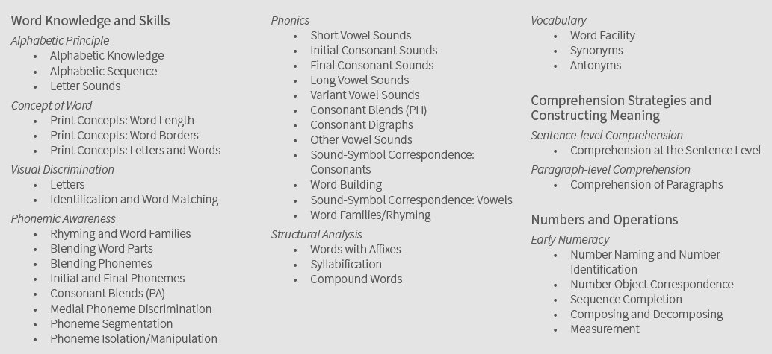
Three key domains

Slide 8
How computer-adaptive testing works
More
Difficult
Easier
Items answered by a student
Correct Response
Incorrect Response
Standard Error of Measurement
Notes:
This slide illustrates how a computer adaptive assessment works. Its similar to iready that we use in our district
It detects the age/grade of the student and offers a very simple grade level item as the first item.
If the student answers correctly they will get a more difficult item, if they answer incorrectly the next item will be slightly easier, this same pattern will continue for the entire administration of the assessment.
As you can see in the graphic the bar, which represents “error” continues to get smaller and smaller as the system narrows down the range of the student’s true ability level. By the end of the assessment the error is very small.
After 27 questions, it can be determined with high accuracy the level of skill mastery for each student.

Slide 9

Star Early Literacy Scaled Score (SS)
Scaled Score Range
300 – 900

Slide 10
Preparing for the assessment
Notes:
There is preliminary work that must happen for our screening of students to go well.

Slide 11
Who should be tested?
Incoming Kindergarten Students
  All public students must test
  Private school students may test
    At their school site
    VPK students may request to test in public school.

Slide 12
Ensuring test fidelity
Administer Star Assessments appropriately so you can rely on the data to make instructional decisions.
Plan
for assessment
Prepare
students to test
Motivate
students to do
their best
Monitor
students during testing

Slide 13
Planning for assessment
Download the Star Early Literacy Test Administration Manual
  http://www.fldoe.org/core/fileparse.php/18494/urlt/StarEarlyLiteracy-TAM.pdf
FLKRS Assessment Site (different than district Renaissance platform)
  You can access your FLKRS Assessment site from the FLKRS website.
Train kindergarten teachers prior to the administration of STAR
Parent letters
Testing window (August 23 – October 6, 2021)
Testing schedule (computer labs/classrooms)
Prepare technology (Check system requirements pg. 1 of the TAM)
  desktops, tablets
  keyboards/mouse/touchscreen
  headphones
Provide student username/passwords

Slide 14
Prepare for assessment
View introductory video with students
Explain the reasons for testing
Explain that they will be using headphones
Tell students what they will do when they complete their test
Plan for accommodations such as extended time
Students must be provided the opportunity to try a practice test
Practice test instructions
  http://www.fldoe.org/core/fileparse.php/18494/urlt/SELPI.pdf

Slide 15
Monitor students
Actively monitor students
Have multiple monitors if possible
Monitors should be aware of best practices

Slide 16
Let’s practice!

Slide 17
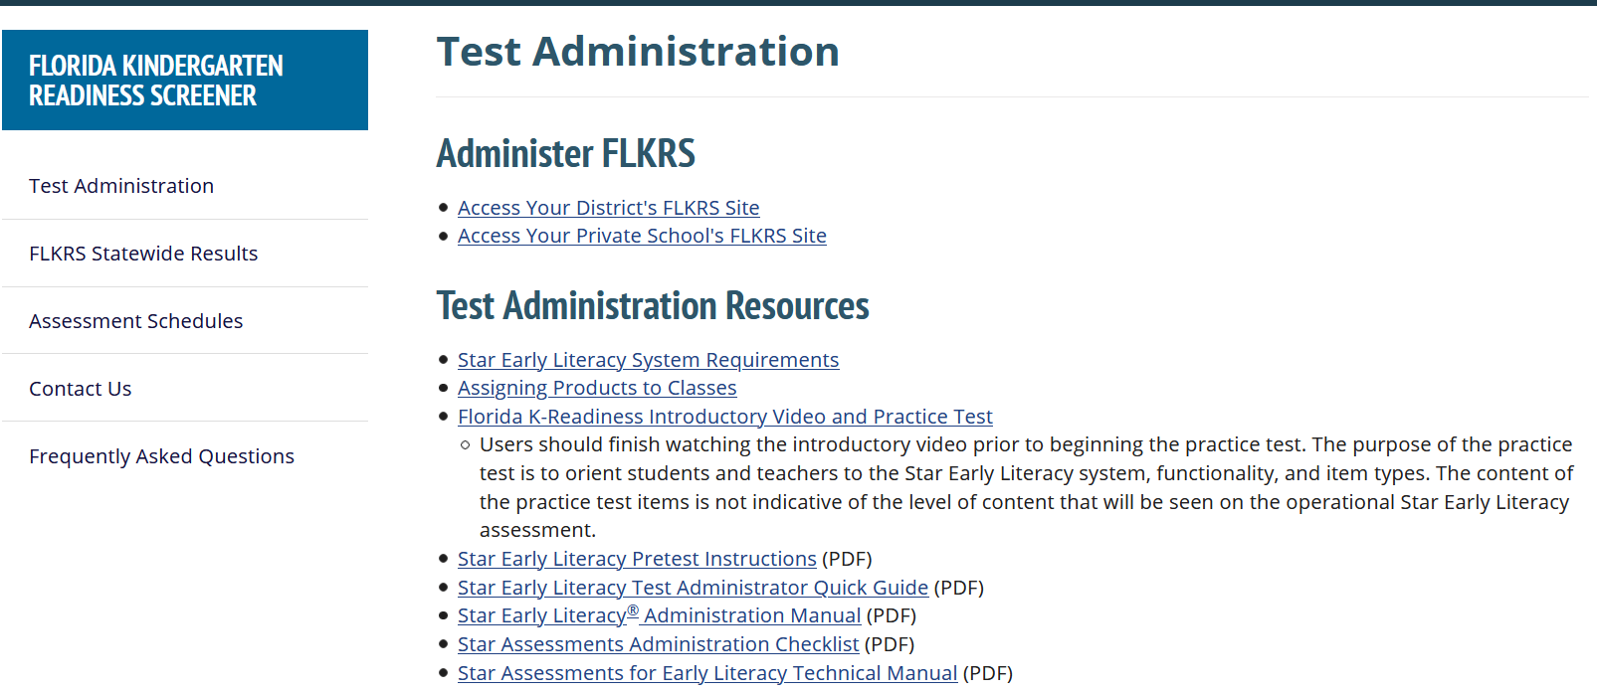
FLDOE FLKRS Resource Site
http://www.fldoe.org/accountability/assessments/k-12-student-assessment/flkrs

Slide 18

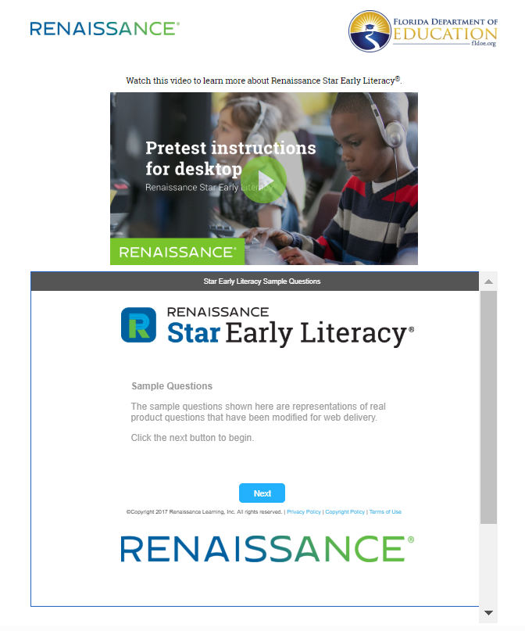
Introductory video
Microsoft Edge Chromium & Safari
Chrome & Firefox
Notes:
When you click on the Florida K-Readiness Introductory Video and Practice Test you will be taken to a practice page. On this page there are two resources, on the top is a video demonstrating how to use the mouse and or keyboard to take the assessment. The bottom page is a list of 7 sample questions. It is recommended that you share this with your students before they take the assessment, either in a lab so they can practice themselves, or model the practice by showing the video and sample questions in your classroom. (Image is hyperlinked)
There will be some questions in the list of 7 sample questions that your kindergarten students will possibly not be able to answer. This is a perfect opportunity to explain to your students that they will see questions on the FLKRS test that they cannot answer. Explain to them that when they don’t know the answer that they need to pick what they feel is the best answer and move to the next question.

Slide 19
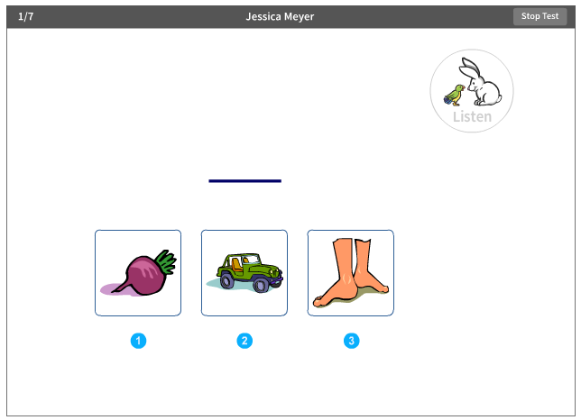
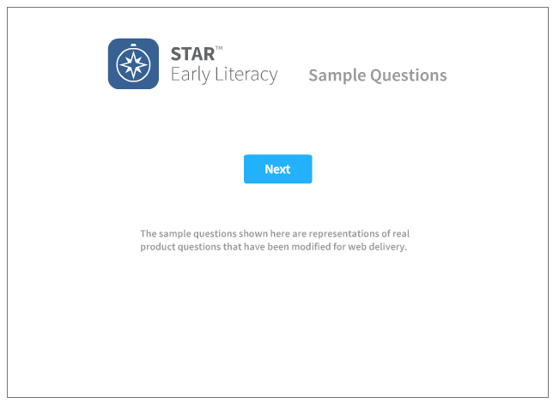
Practice sample questions

Slide 20
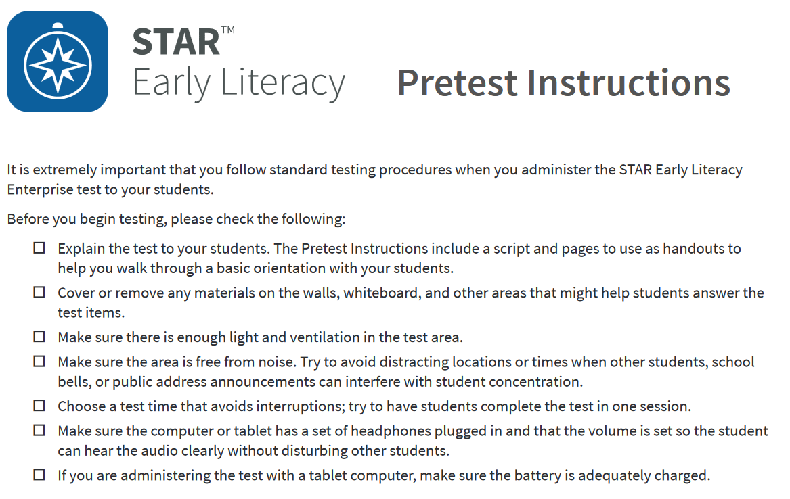

Slide 21
Printing the student roster

Slide 22
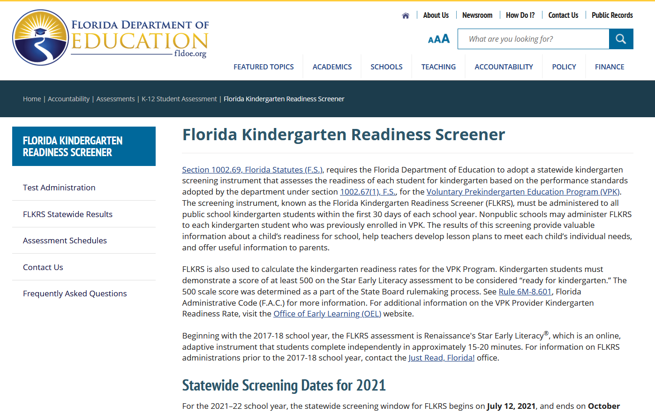
Access your district FLKRS site
http://www.fldoe.org/accountability/assessments/k-12-student-assessment/flkrs
Notes:
The next few slides are a step by step process on how to access your district FLKRS assessment site. First access the FLKRS web page: http://www.fldoe.org/accountability/assessments/k-12-student-assessment/flkrs and click on Test Administration.

Slide 23
Teacher Logins
Kindergarten teachers’ names will be populated in the Renaissance Place platform for the 2021-22 school year.
Teachers will NOT be able to use their login information from last year. Teachers will be prompted to change their passwords
NEW: Will prompt to enter an email.
Procedures for teacher logins:
  Username: Employee number (i.e. 123456)
  Password: FLKRS2021!

Slide 24
Admin Logins
School Assessments Coordinators will login with following credentials
Username: location number_Principal (i.e. 1234_Principal)
Password: FLKRS2021
Function of Admin Login
  Add new teacher if needed
  Pull student logins
  Pull overall school level FLKRS data
  Logins will not activate until the first day of the testing window.

Slide 25
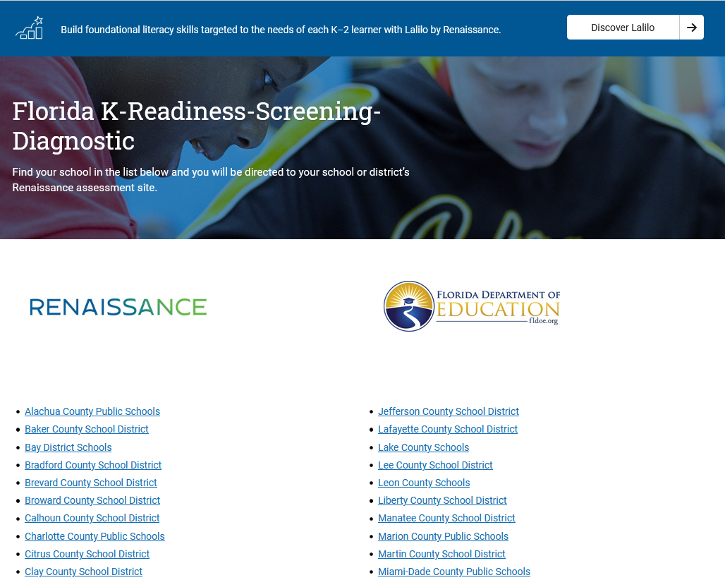
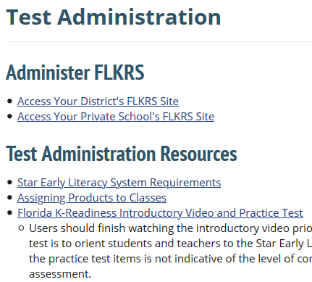
Access your district FLKRS site
http://www.fldoe.org/accountability/assessments/k-12-student-assessment/flkrs
Click “Access your District’s FLKRS Site”
Select your district from the list

Slide 26
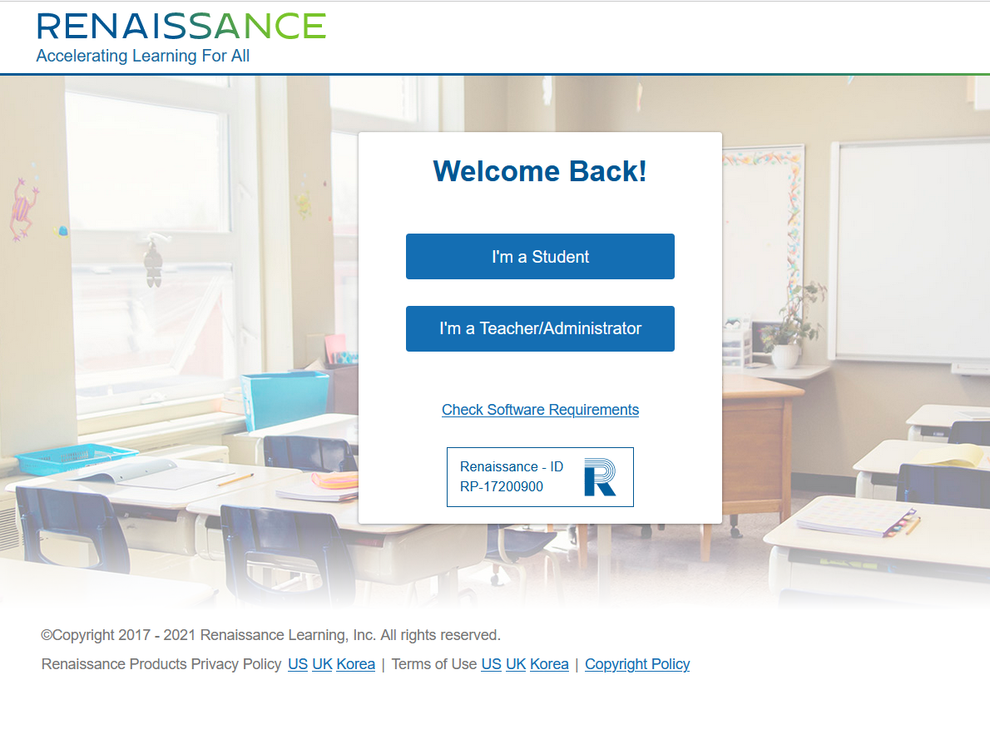
Teacher/Administrator Login

Slide 27
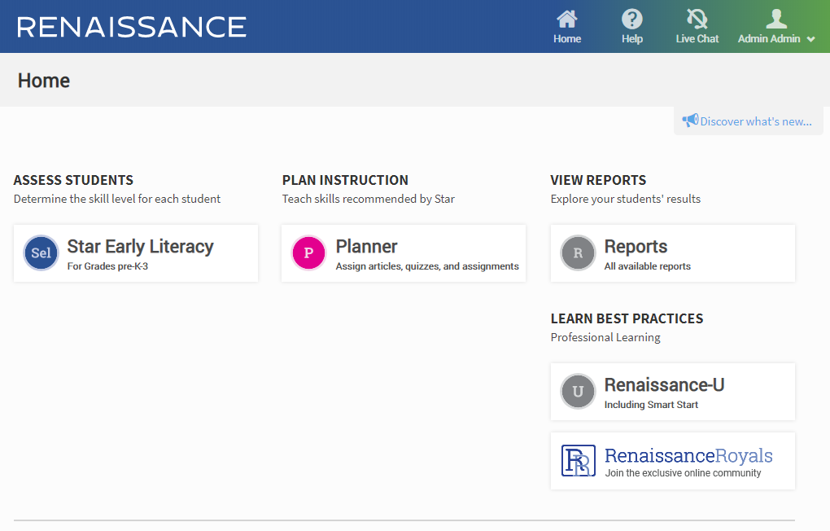
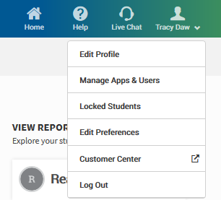
Print student roster

Slide 28
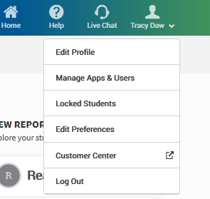
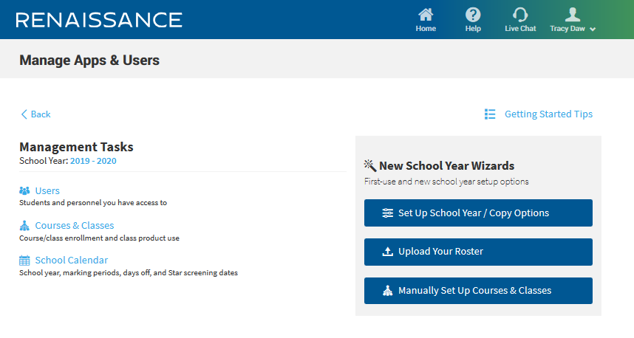

Print student roster

Slide 29
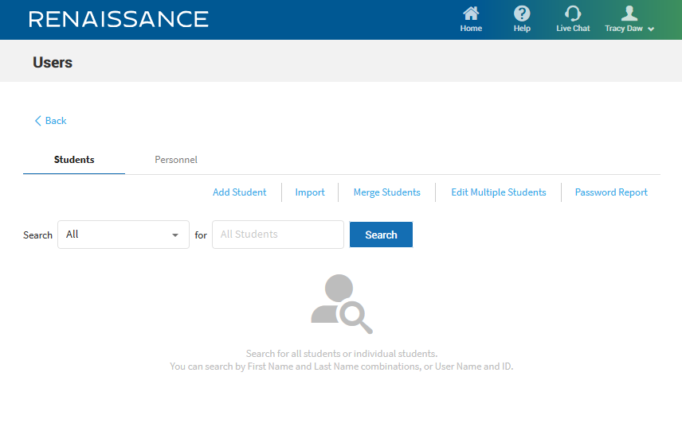
Print student roster

Slide 30
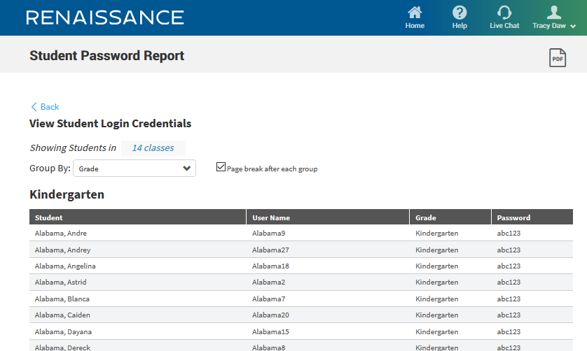
Print student roster
Notes:
This is a sample view where you can view the names of the students with their username and password. On the top right corner, you can click on the print icon if you prefer a hard copy.

Slide 31
Non-participation characteristics

Slide 32
Non-Participation Characteristics
How to select characteristics

Slide 33
Non-Participation Characteristics
How to select characteristics

Slide 34
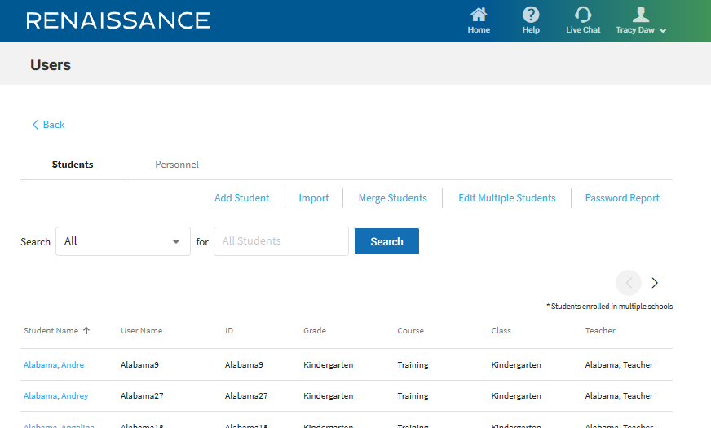
Non-Participation Characteristics
How to select characteristics

Slide 35
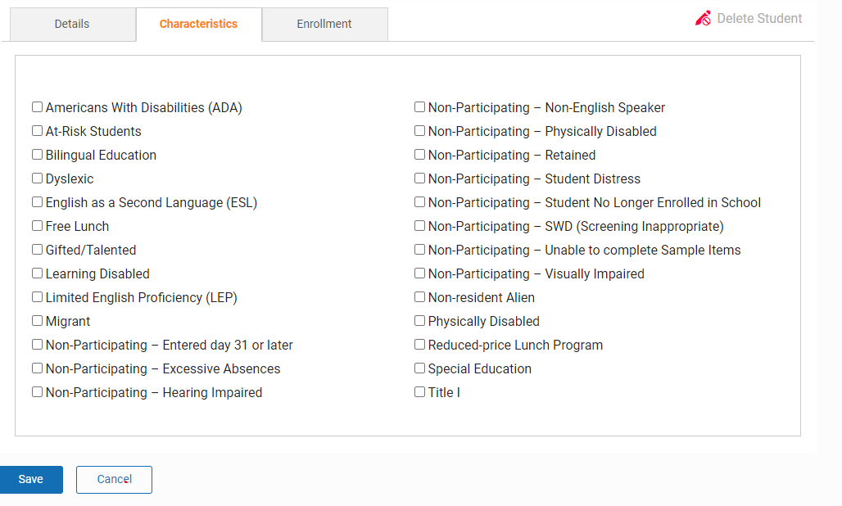
Non-Participation Characteristics
How to select characteristics

Slide 36
Assessing students

Slide 37
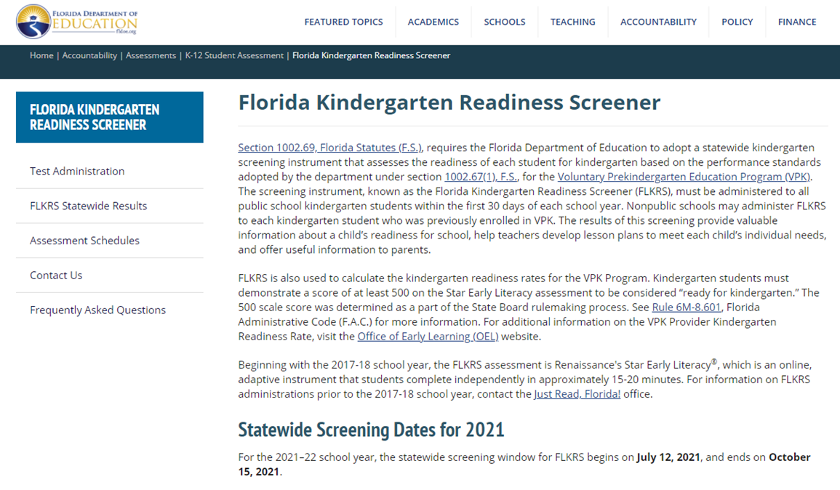
Access your district FLKRS site
http://www.fldoe.org/accountability/assessments/k-12-student-assessment/flkrs

Slide 38
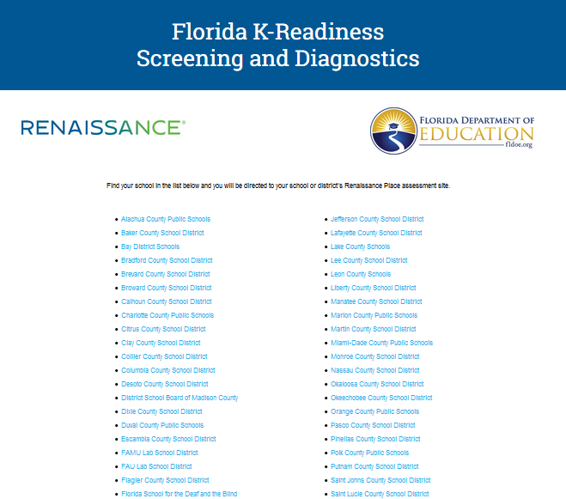
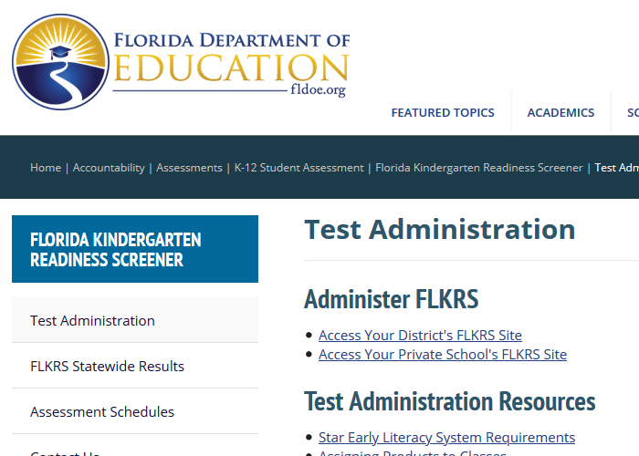
Access your district FLKRS site
http://www.fldoe.org/accountability/assessments/k-12-student-assessment/flkrs
Click “Access your District’s FLKRS Site”
Select your district from the list

Slide 39

Student login
Notes:
Select I’m a Student

Slide 40

Students
Usernames – FLEID – all lowercase
Example: fl123456789101
Passwords – first name – case sensitive
Username and Password information can be found in the Password Report

Slide 41
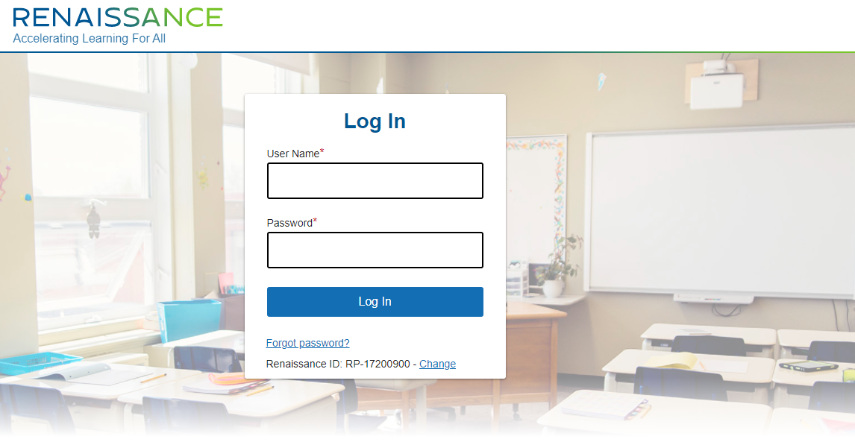
Student login
Notes:
Enter the student’s user name and password.

Slide 42
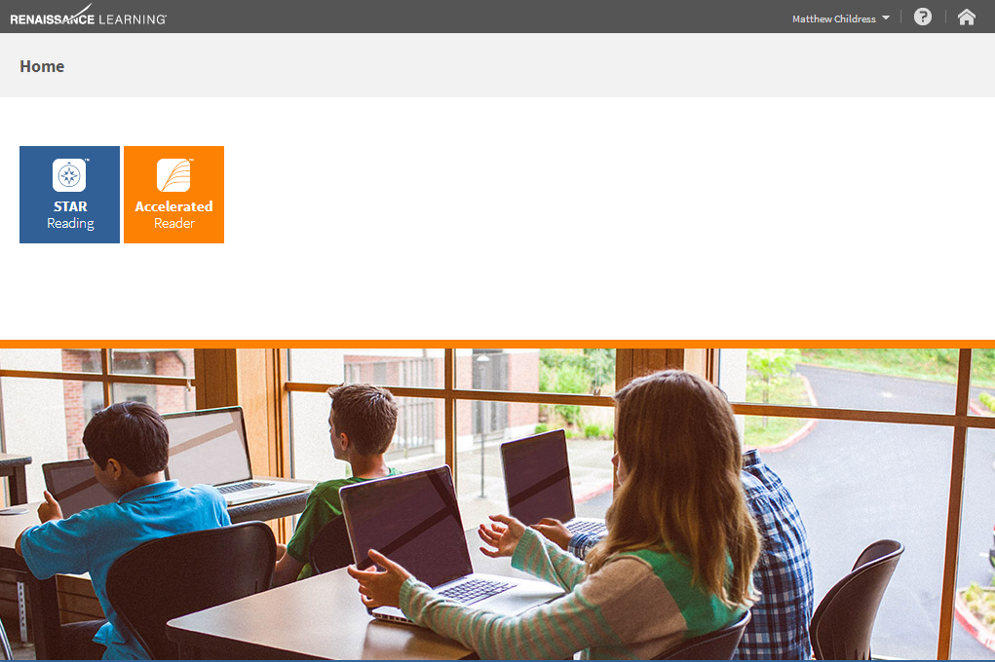
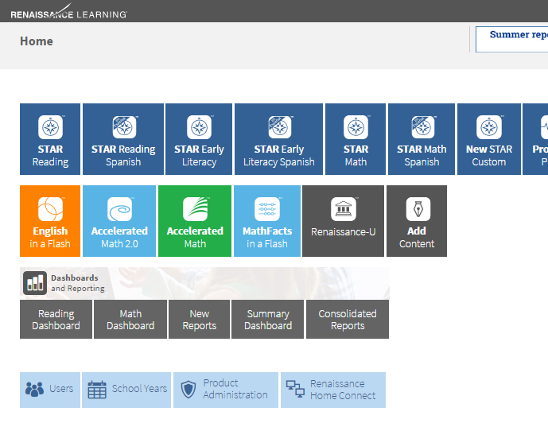
Launch Star Early Literacy
John Tyler

Slide 43
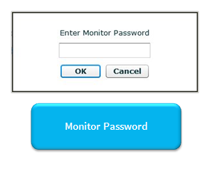
Launch Star Early Literacy
Notes:
The default monitor password is ADMIN. The monitor password will also come up if you stop the test and then resume it.

Slide 44
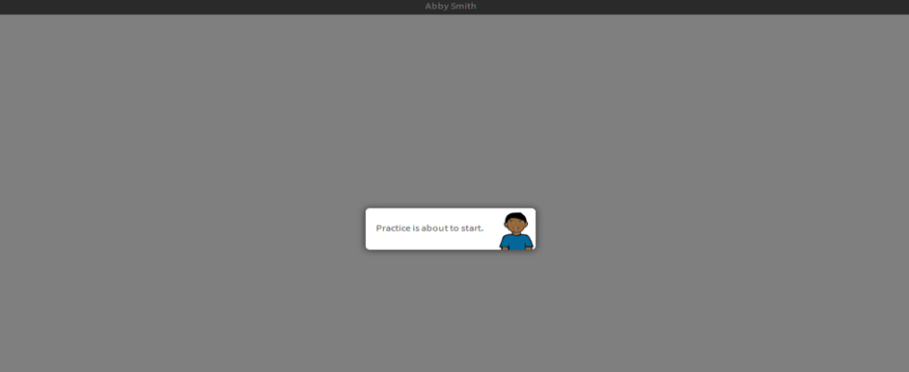
Begin practice

Slide 45
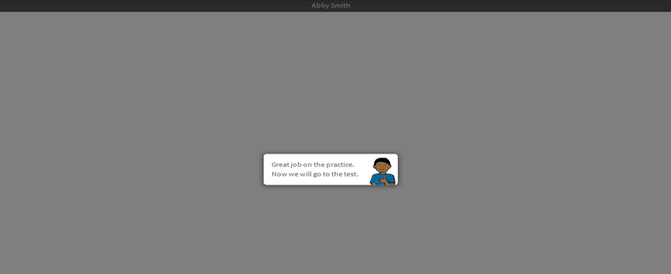
Begin the test
Notes:
After the student has successfully answered three practice questions correctly they will get a congratulations message and will then be taken to the assessment.

Slide 46
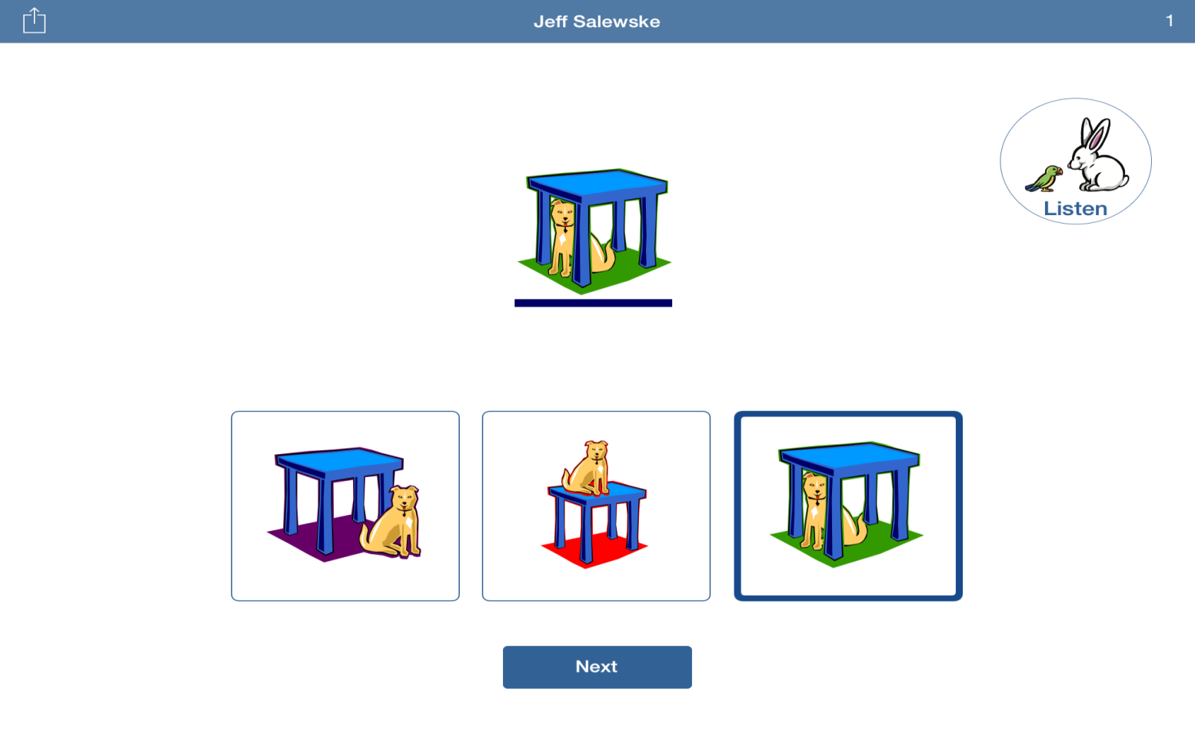
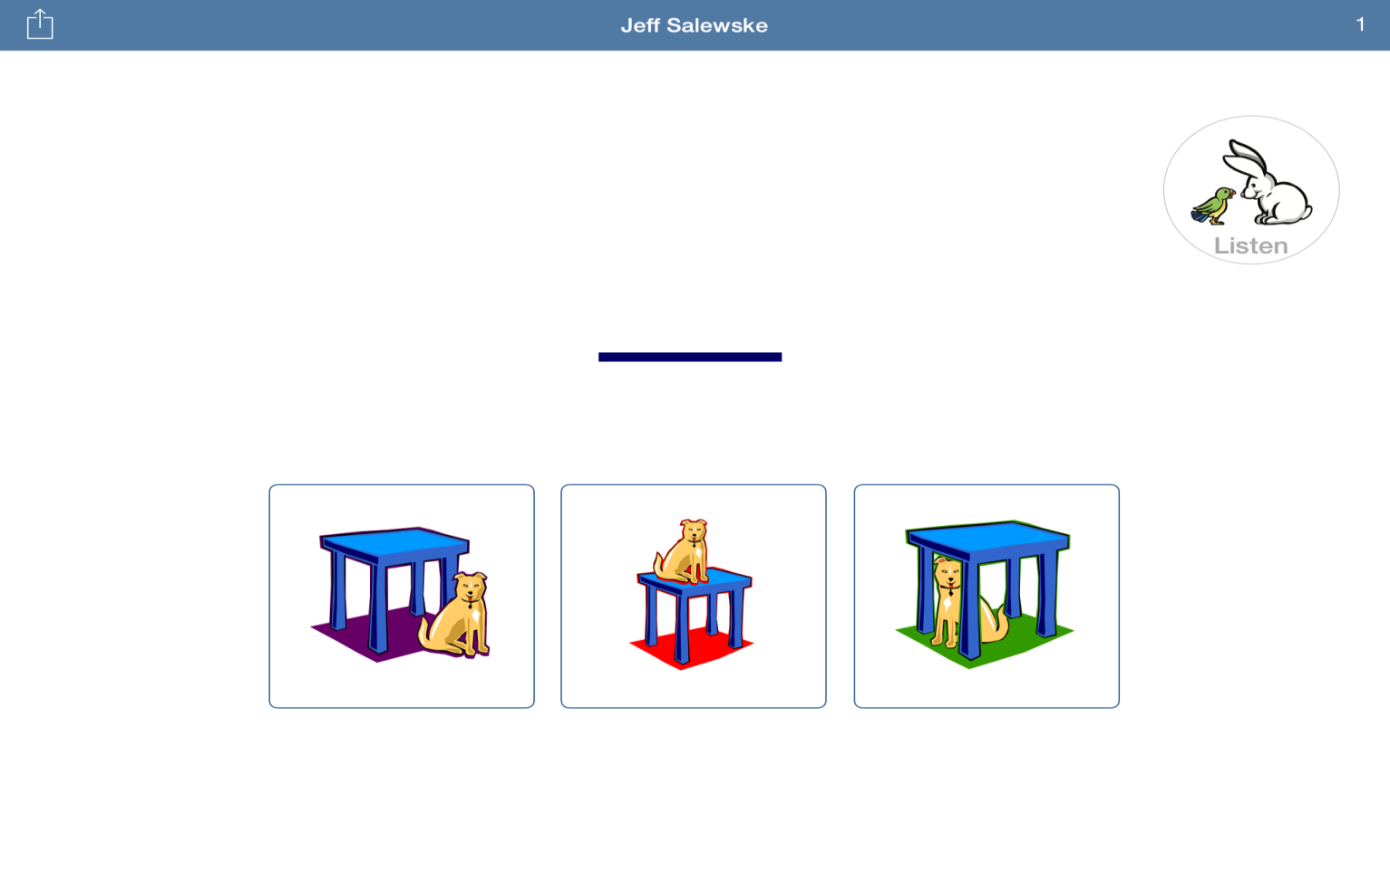
Sample item

Slide 47
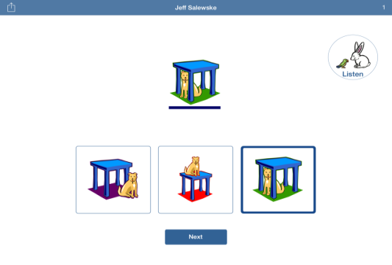
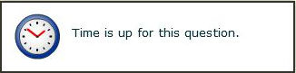
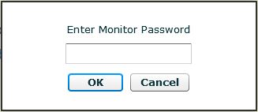
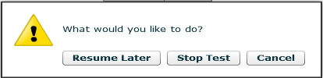
Practice Items
Item Time Limits
Pause or Stop a Test
(Ctrl + A)
Monitor Password

Slide 48
Accessing reports

Slide 49

Reports
Student
Class
School
Notes:
We will cover three levels of reports.
Student
Class
School

Slide 50
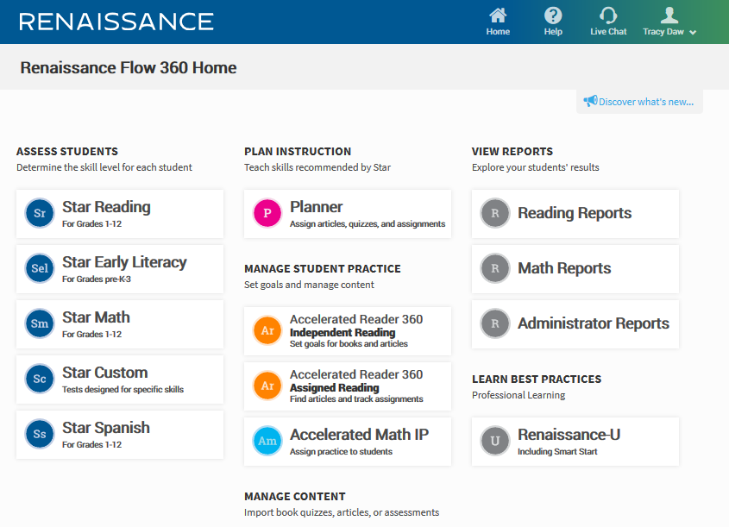

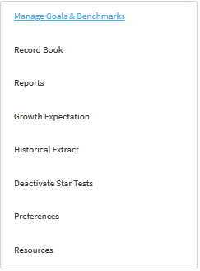
Teacher/Administrator Home Page

Slide 51
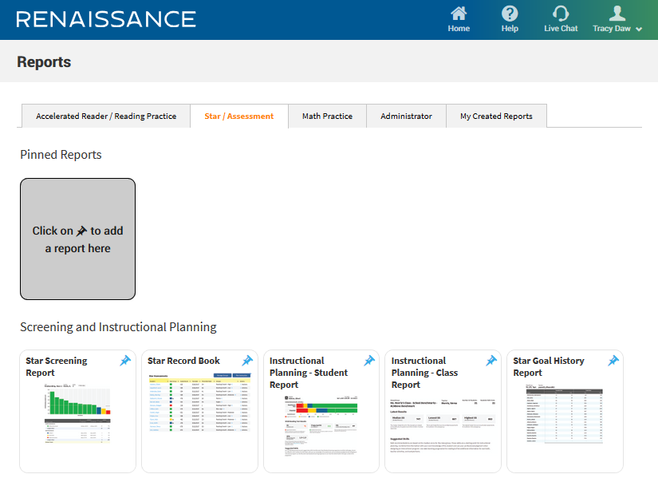
Reports Available
Notes:
Next, you want to click on the Star Assessment tab to view the types of reports that are available.

Slide 52
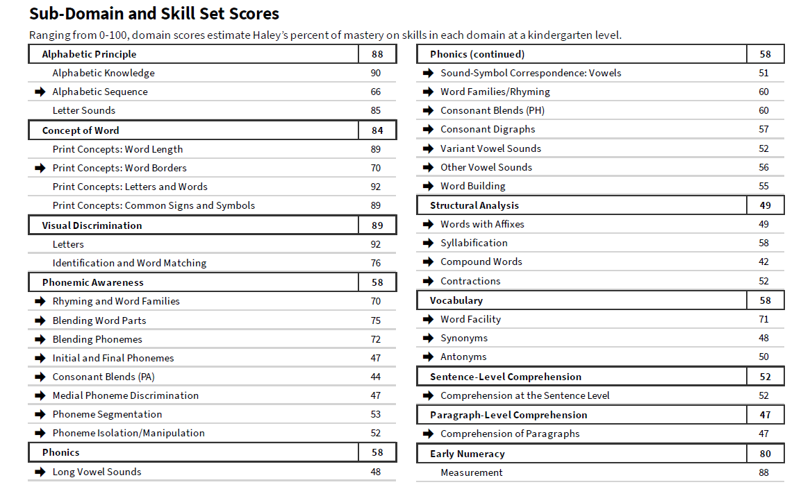
Star Early
Literacy
Reports
Diagnostic Report
Student Level

Slide 53
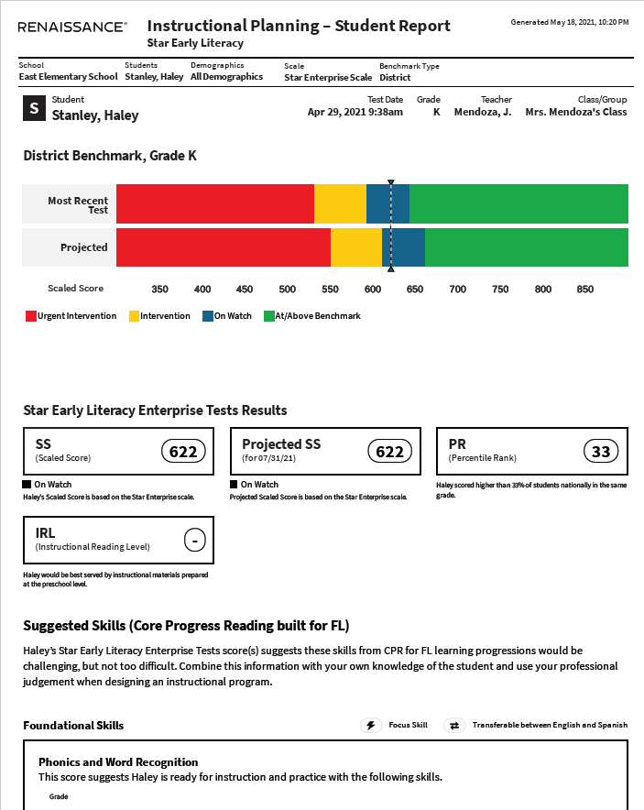
Star Early
Literacy
Reports
Instructional Planning
Student Level

Slide 54
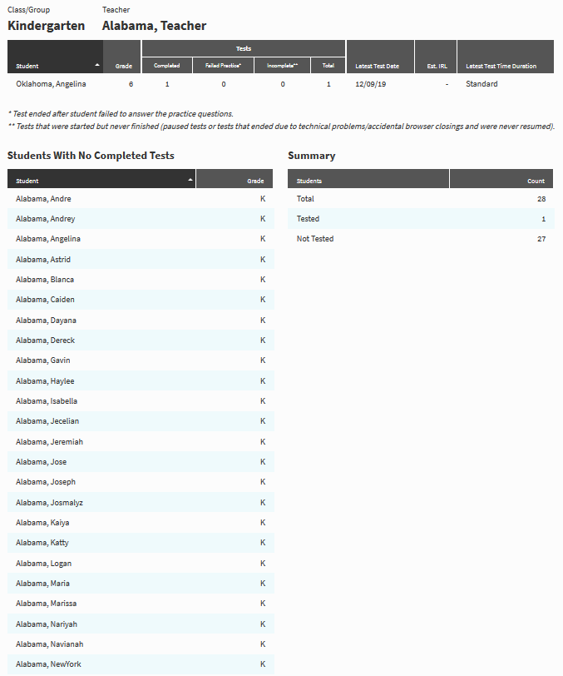
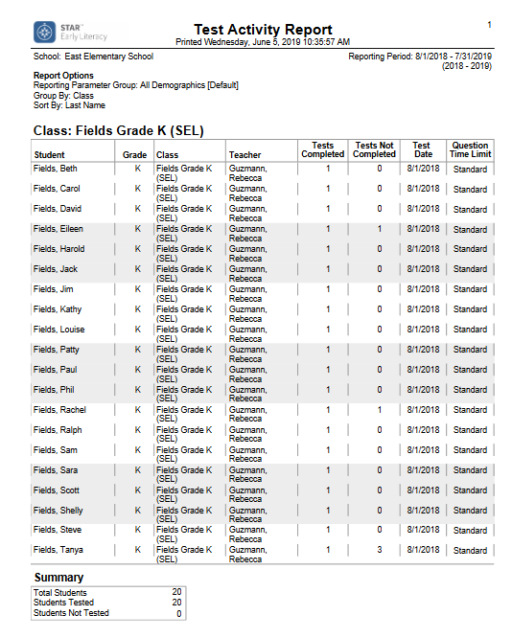
Star Early
Literacy
Reports
Test Activity
Class Level

Slide 55
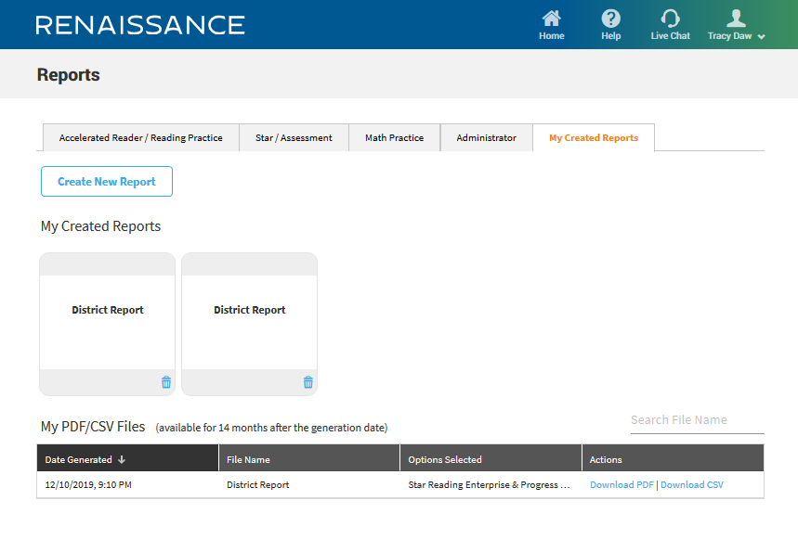
My Created Reports
Notes:
Its very important that once all of the students have tested that a school list of results with the corresponding scale score be printed. Remember an official FLDOE list of scores for your school will not be available to download until winter. However, with the FLKRS assessment, you do access right away to the scores so make a copy for your records.

Slide 56
Support and Resources

Slide 57
Teacher/Administrator Home Page

Slide 58
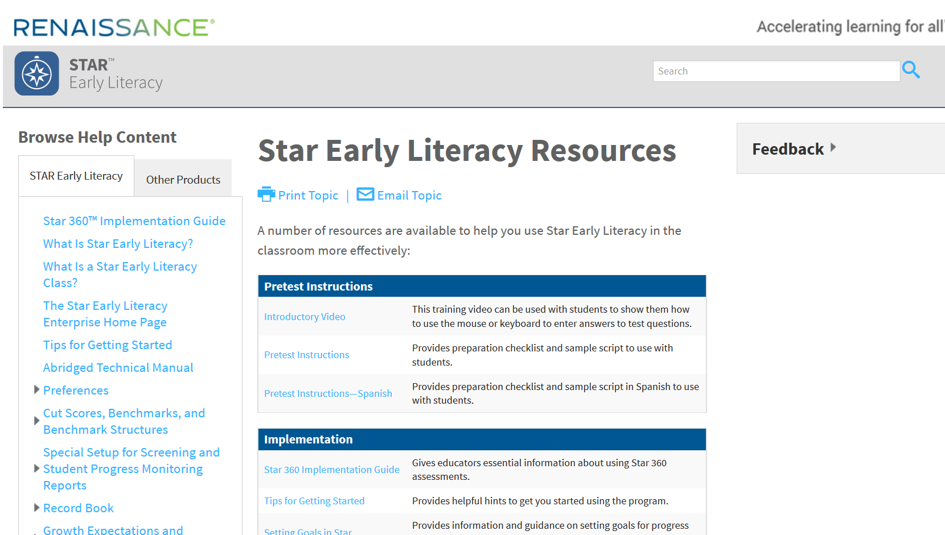

Slide 59
Key Contacts for Star Early Literacy Implementation
  Miami Dade District FLKRS Contacts:
    Mayda Cabeza, Director, I, Assessment, Research and Data Analysis: mcabeza@dadeschools.net or 305-995-7520
  Renaissance Learning Contacts:
    Email Support: flkreadiness@renaissance.com
    Florida K-Readiness Renaissance Place Help Desk: 1-800-338-4204

Slide 60
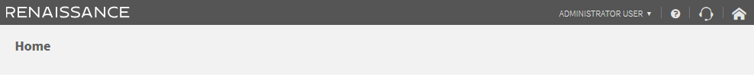

Renaissance Place Help
Help at your fingertips
Help
  Searchable
  Specific to the page you’re on
Live Chat support
  Always live
  Always ready

Slide 61
Renaissance.com
We’re here for you!
Email help
  answers@renaissance.com
  Get answers quick
Give us a call
  1-800-338-4204
  Never a recording
FLKRS Specific
  flkreadiness@renaissance.com

